Slide 1
I/O FUNDAMENTALS

Slide 2
Introduction
The I/O subsystem provides an efficient mode of communication between CPU and outside environment
Devices that are under the direct control of computer are said to be connected on-line
Input or output devices attached to the computer are also referred as peripherals.
I/O interface or I/O Module provides a method for transferring information between internal storage and external i/o devices.

Slide 3
IO interface/IO module
Resolves the differences between the computer and peripheral devices
-Design
Peripherals - Electromechanical Devices
CPU or Memory - Electronic Device
- Data Transfer Rate
Peripherals - Usually slower
CPU or Memory - Usually faster than peripherals
Some kinds of Synchronization mechanism may be needed
- Unit of Information
Peripherals - Byte
CPU or Memory - Word
- Operating Modes
Peripherals - Asynchronous
CPU or Memory - Synchronous

Slide 4
Input/Output Problems
• Wide variety of peripherals
– Delivering different amounts of data
– At different speeds
– In different formats
• All slower than CPU and RAM
• Need I/O modules

Slide 5
Input/Output Module
• Interface to CPU and Memory
• Interface to one or more peripherals

Slide 6
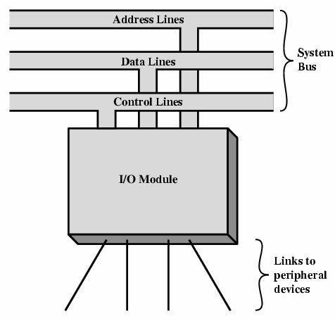
Generic Model of I/O Module

Slide 7
I/O Module Function
• Control & Timing
• CPU Communication
• Device Communication:- BUSY, READY signal
• Data Buffering
• Error Detection

Slide 8
I/O Steps
• Steps needed to transfer data to or from external device to
CPU:
1. CPU checks I/O module device status
2. I/O module returns status
3. If ready, CPU requests data transfer
4. I/O module gets data from device
5. I/O module transfers data to CPU

Slide 9
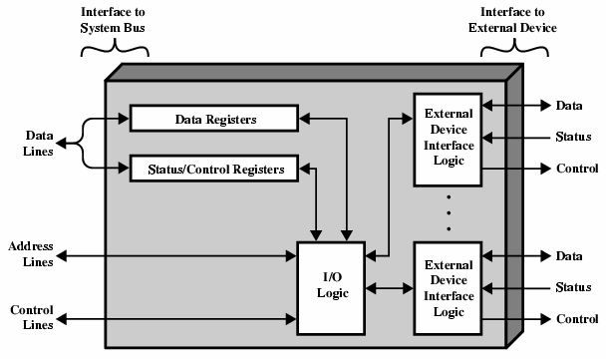
I/O Module Diagram

Slide 10
I/O Bus and Memory Bus
  MEMORY BUS is for information transfers between CPU and the Main Memory.
  I/O BUS is for information transfers between CPU and I/O devices through their I/O interface.
  Many computers use a common single bus system for both memory and I/O interface units
  - Use one common bus but separate control lines for each function
  - Use one common bus with common control lines for both functions

Slide 11
Data
Address
Read
Write
Main Memory
CPU
IO Port 1
IO Port 2
IO Port 3
IO Device A
IO Device B
Memory-Mapped I/O
Data
Address
Read M
Read IO
Write M
Write IO
Main Memory
CPU
IO Port 1
IO Port 2
IO Port 3
IO Device A
IO Device B
I/O Mapped I/O

Slide 12
Isolated I/O
Isolated I/O
- Separate I/O read/write control lines in addition to memory read/write control lines
- Separate (isolated) memory and I/O address spaces
Distinct input and output instructions
When CPU fetches and decodes the opcode of an I/O instruction, it places the address into the common address lines. Also enables read/write control lines => the address in the address lines is for interface register and not for a memory word.

Slide 13
Memory Mapped I/O
  A single set of read/write control lines
  Memory and I/O addresses share the common address space .
    Reduces memory address range available.
  No specific input or output instruction
  The same memory reference instructions can be used for I/O transfers
  When the bus sees certain addresses, it knows they are not memory addresses, but are addresses for accessing I/O devices.
  -

Slide 14
Asynchronous Data Transfer
Synchronous - All devices derive the timing information from common clock line.
Asynchronous - No common clock
Asynchronous Data Transfer:-
Asynchronous data transfer between two independent units requires that control signals be transmitted between the communicating units to indicate the time at which data is being transmitted

Slide 15
Asynchronous Data Transfer
Two Asynchronous Data Transfer Methods:
Strobe pulse :-
- A strobe pulse is supplied by one unit to indicate the other unit when the transfer has to occur
Handshaking:-
- A control signal is accompanied with each data being transmitted to indicate the presence of data
- The receiving unit responds with another control signal to acknowledge receipt of the data

Slide 16
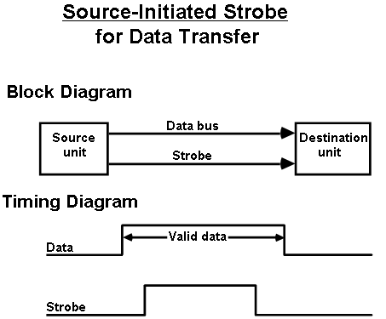
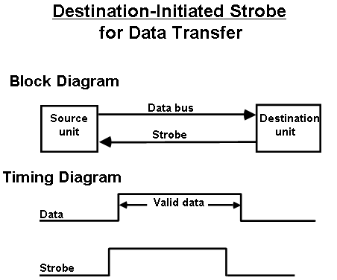
Strobe Control
The strobe may be activated by either the source or the destination unit
Data bus carries the binary information from source to destination

Slide 17
Source initiated strobe
It could be a memory write control signal from the CPU to a memory unit.
Source is the CPU, places a word on the data bus and informs the memory unit which is destination, that this is a write operation.
Disadvantage – no way of knowing whether the destination unit has actually received data.

Slide 18
Destination initiated strobe
It could be a memory read control signal.
CPU, the destination initiates the read operation to inform the memory which is the source to place a selected word into the data bus.
Disadvantage - no way of knowing whether the source has actually placed the data on the bus

Slide 19
Hand Shaking
The handshake method introduces a second control signal to provide a reply to the unit that initiates the transfer.
2 types
  Source initiated transfer
  Destination initiated transfer
Provides high degree of flexibility and reliability
Incompletion of data transfer can be detected by means of a timeout mechanism
The timeout signal can be used to interrupt the processor and hence execute a service routine that takes appropriate error recovery action.

Slide 20
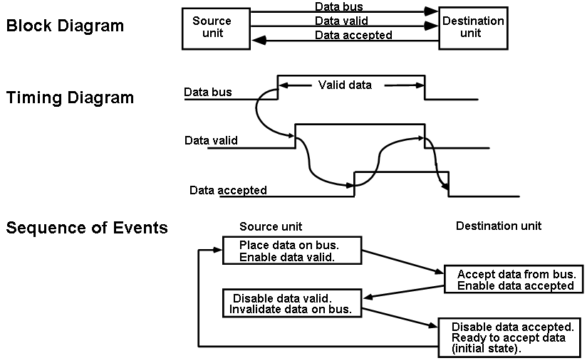
SOURCE-INITIATED TRANSFER USING HANDSHAKE

Slide 21
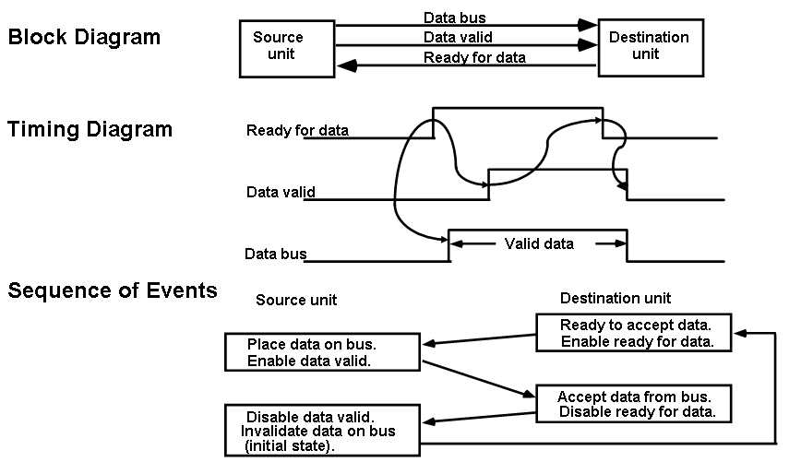
DESTINATION-INITIATED TRANSFER USING HANDSHAKE

Slide 22
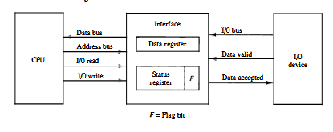
Strobe pulse: Data transfer between CPU and Interface
Handshaking signals:- Data transfer between IO interface and peripheral device.

